Slide 1
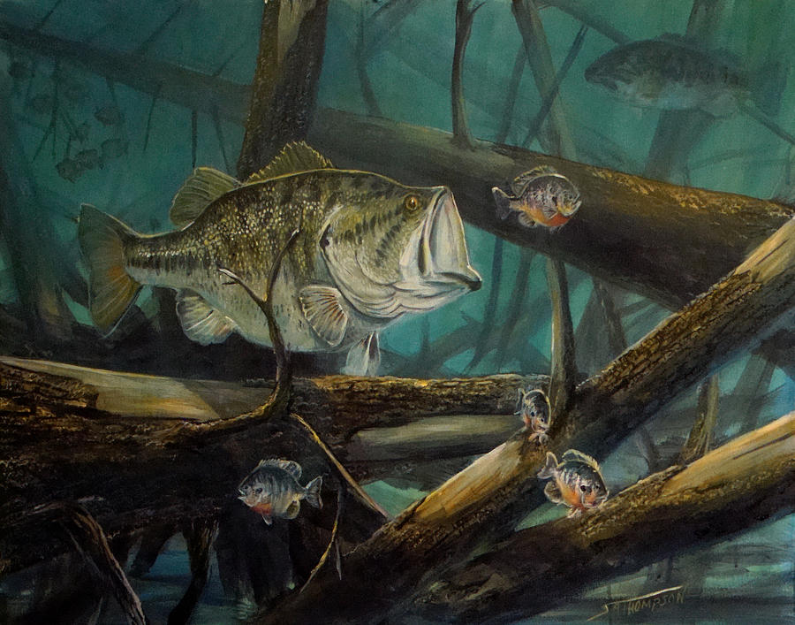
Life Histories

Slide 2
Learning Goals
Explain why organisms do not begin reproducing as soon as they are born, produce an infinite number of offspring, and live forever
Provide and explain examples of life history trade-offs

Slide 3
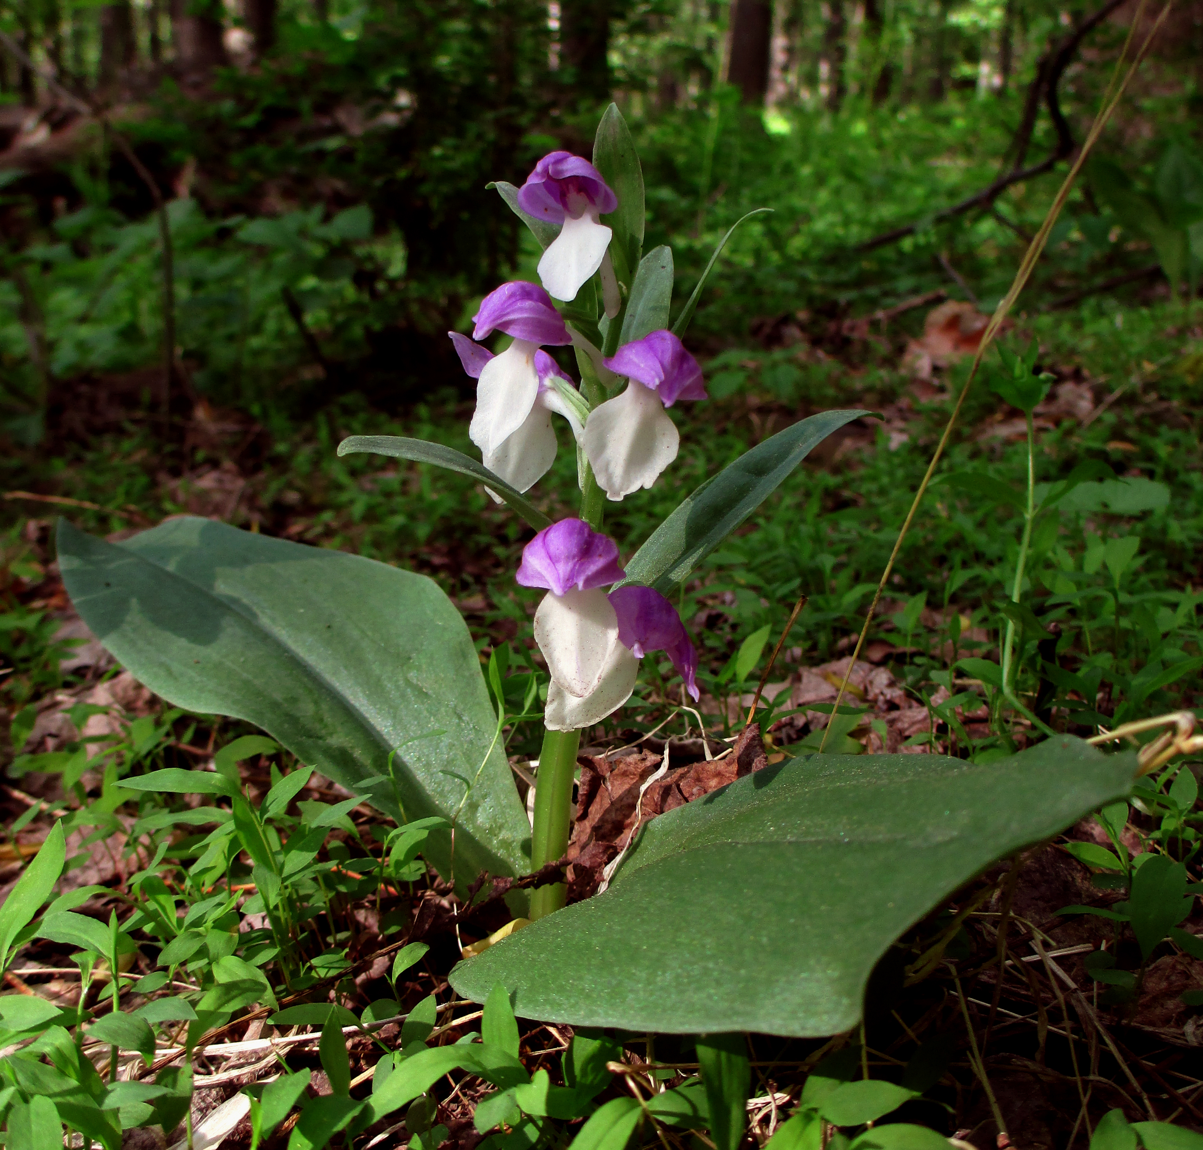
What are life histories?
Natural selection favors traits that improve an organism’s likelihood of survival and reproductive success
Traits that affect an organism’s schedule of reproduction and survival make up its life history

Slide 4
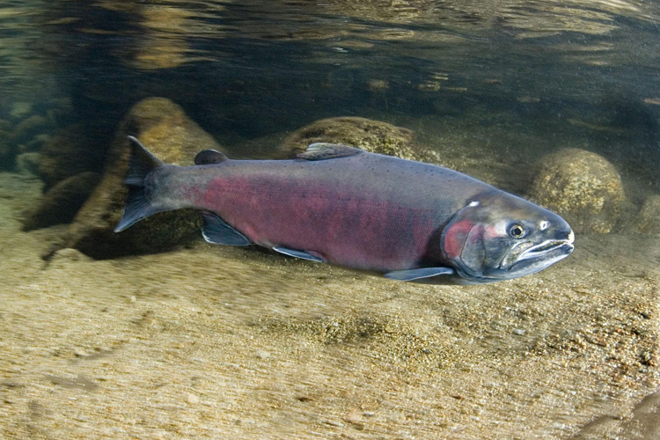
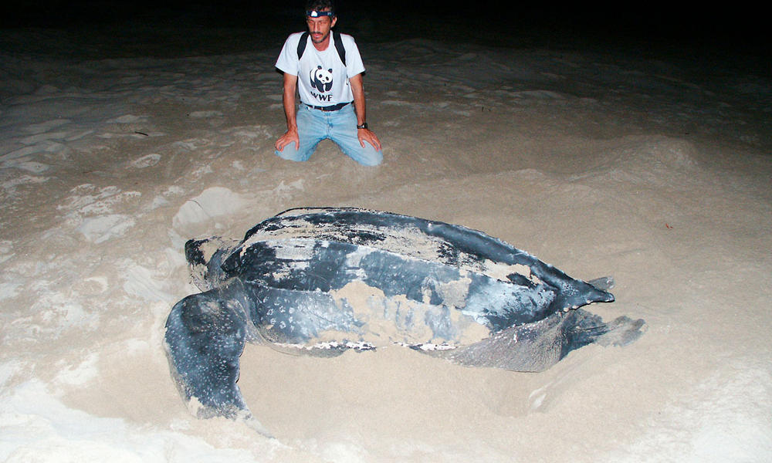
How long should an organism wait before beginning to reproduce?
E. coli - 20 minutes
Coho salmon - 3-4 years
Leatherback sea turtle - 30 years

Slide 5
How often should an organism reproduce?
Semelparity - reproduce once (coho salmon)
Iteroparity - repeated reproduction (leatherback sea turtle)

Slide 6
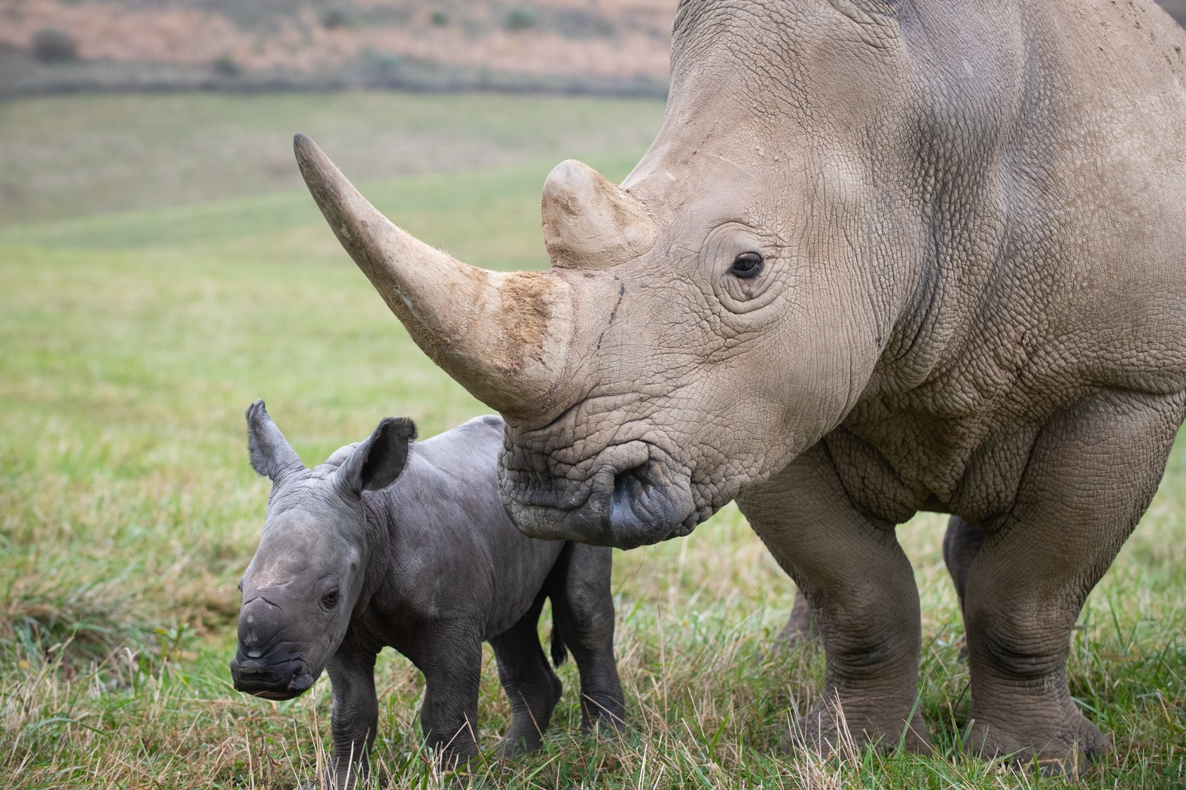
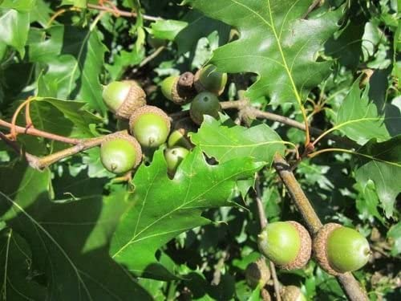
How many offspring should an organism produce per reproductive episode?
White rhino - one calf
Red oak - 10,000 acorns per year

Slide 7
Trade offs and life histories
Investing in one fitness trait takes away resources from another

Slide 8
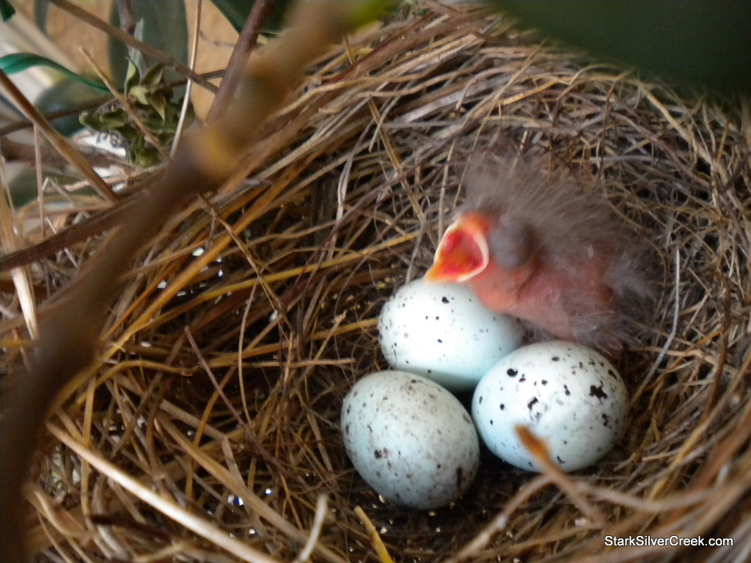
Trade-off: number of offspring produced and parental investment in each offspring
Resources for one function (parental care) come at the expense of another function (producing more offspring)

Slide 9
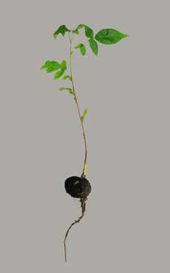
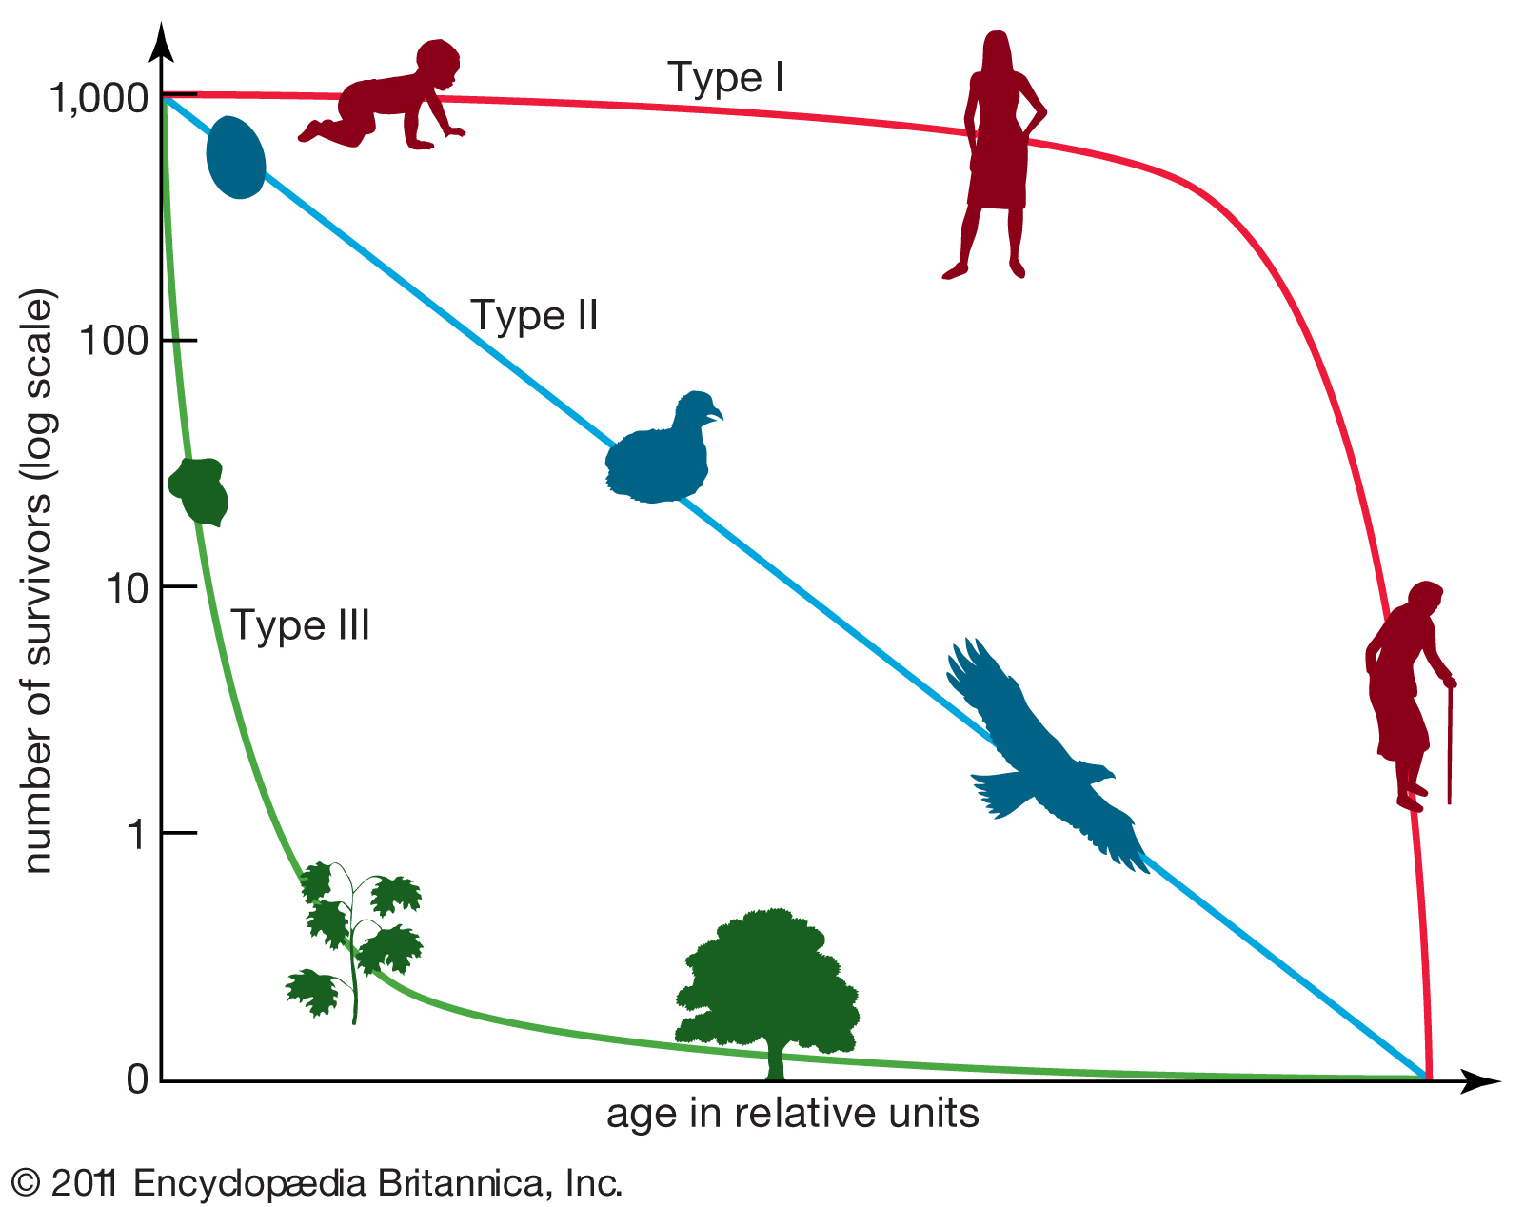
Tradeoffs: number of offspring produced and the size of those offspring
Type 3 survivorship curve—will be under selective pressure to produce lots of small offspring
Type 2 survivorship curve—will be under selective pressure to produce fewer offspring that are larger

Slide 10
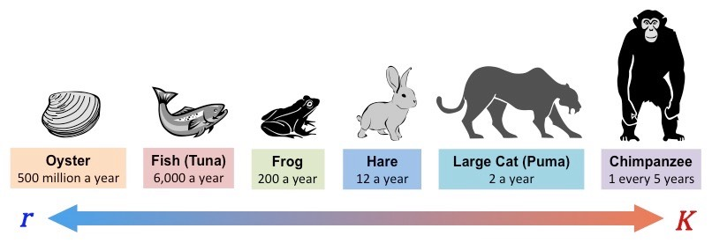
r and K selection

Slide 11
Life Histories

Slide 12
Learning Goals
Differentiate between density-dependent and density-independent factors that affect birth and death rates in populations

Slide 13
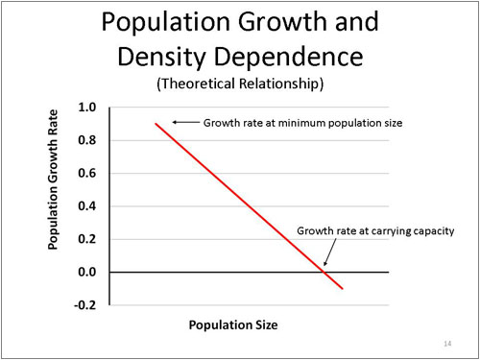
Density-dependent factors limit population growth
When the death rate increases or birth rate declines with increasing population density, the population experiences density-dependent population regulation
Density-dependent factors (usually) cause the population growth rate to decline

Slide 14
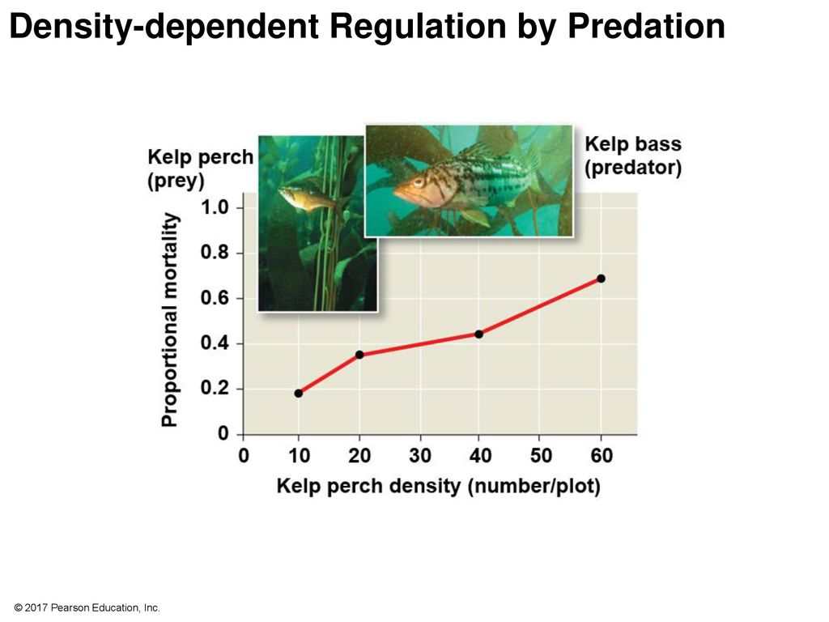

Slide 15
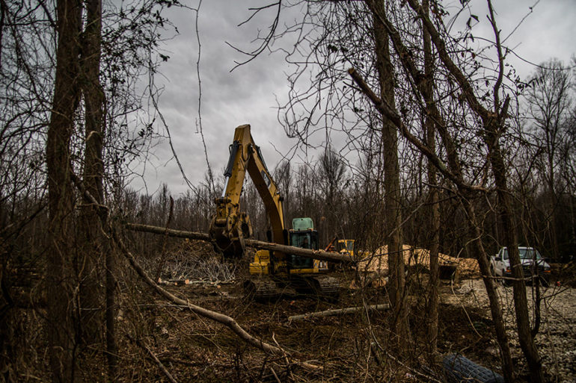

Density-independent factors also affect population growth
Not all factors affecting births or deaths operate in a density-dependent manner
Abiotic factors (deforestation, storms, drought) often have density-independent effects

Slide 16
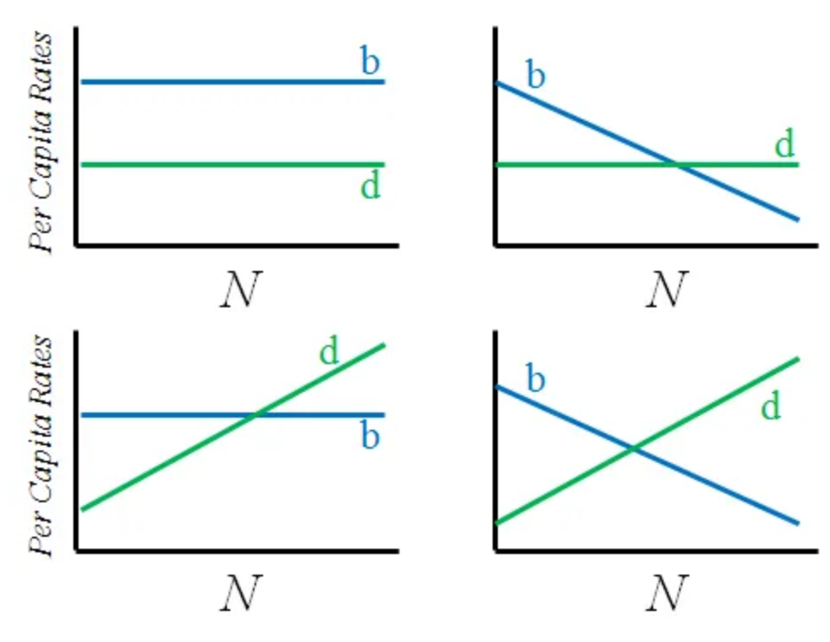
Density dependence versus density independence

Slide 17
Life Histories

Slide 18
Learning Goals
Explain why populations fluctuate
Describe a metapopulation and provide an example

Slide 19
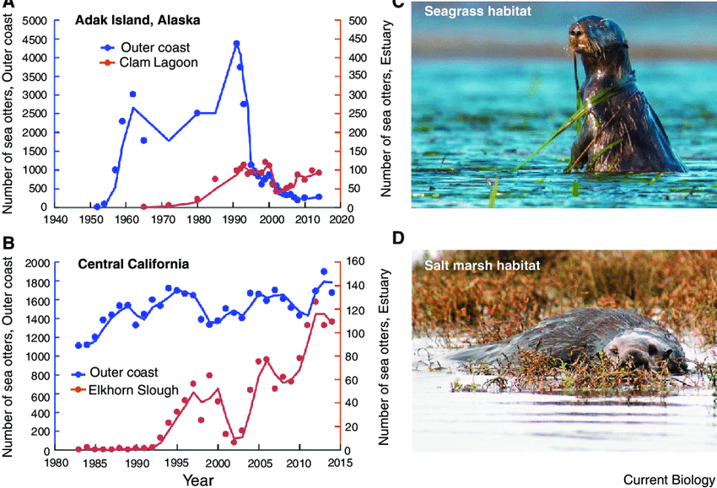
Population dynamics
of sea otters

Slide 20
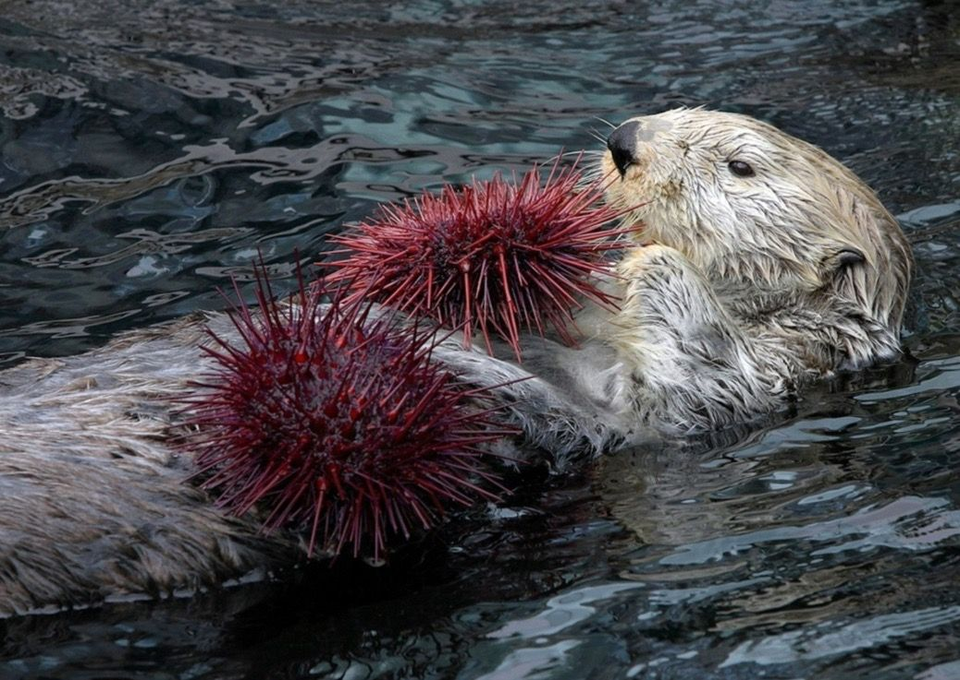
Populations fluctuate
Population dynamics - the fluctuation in population sizes year to year, or place to place
Population dynamics are driven by many factors, and in turn affect other species
(sea otters eat sea urchins. How would the sea urchin population respond with reduced predation pressure when sea otters decline?)

Slide 21
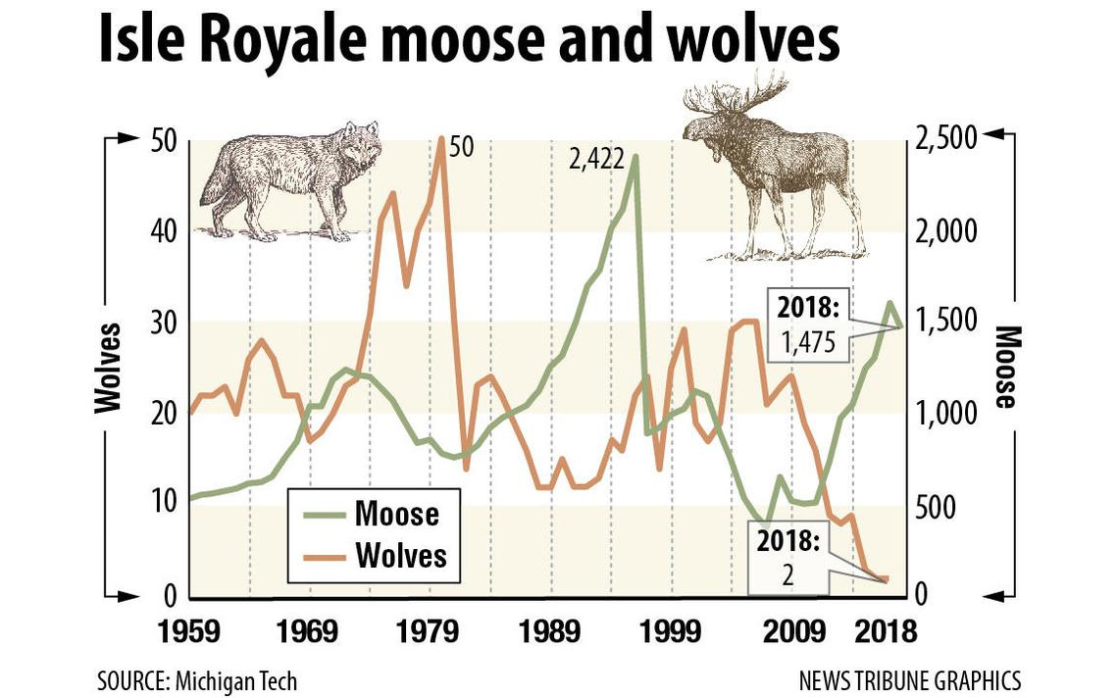
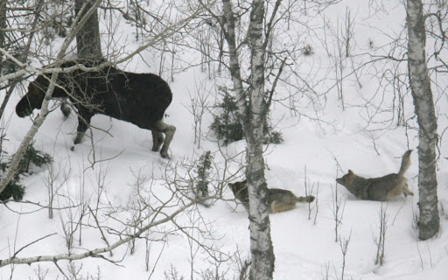

Slide 22
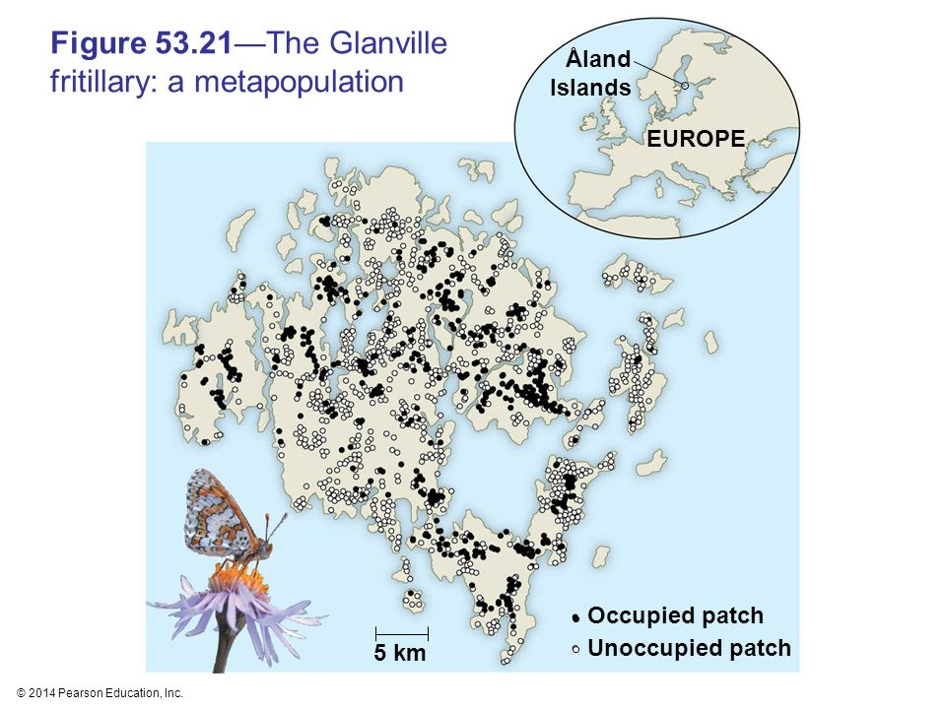
Immigration, emigration, and metapopulations
Metapopulation - isolated habitat patches linked through immigration and emigration
Metapopulations persist due to a balance of immigration and local extinction

